Slide 1
NETW211 Course Project Module 3 Azure VNet and Subnets John Francis – 7/17/2022

Slide 2
Rubric
Activity | Requirement(s) | Points
Creating a VNet with Two Subnets | Questions | 20
Deploying VMs into Subnets | Three Screenshots | 30
Verifying Connectivity between VMs | Two Screenshots | 10

Slide 3
Creating a VNet with Two Subnets
1. With a /24 network prefix, how many usable IPv4 host addresses are there? [hint: you learned this in NETW191]
Answer here: 251
2. Given the answer above, why is the number of available IP addresses for Subnet0 (10.0.0.0/24) or Subnet1 (10.0.1.0/24) shown as 251? [hint: where did the missing addresses go?]
Answer here: The could reserves some of the IP addresses for its own use
1.) 10.0.1.0 – is the network address
2.) 10.0.1.1 – reserved for routing
3.) 10.0.1.2 – reserved for DNS
4.) 10.0.1.3 – reserved for future use, possibly for mapping
5.) 10.0.1.255 – reserved as the broadcast address
References (here are two examples to get your research started):
1. IP Subnet Calculator, https://www.calculator.net/ip-subnet-calculator.html
2. Azure Virtual Network frequently asked questions, https://docs.microsoft.com/en-us/azure/virtual-network/virtual-networks-faq
3. Stactoverflow, https://stackoverflow.com/questions/43298448/why-azure-reserves-first-four-ip-address-of-a-subnet
4.

Slide 4
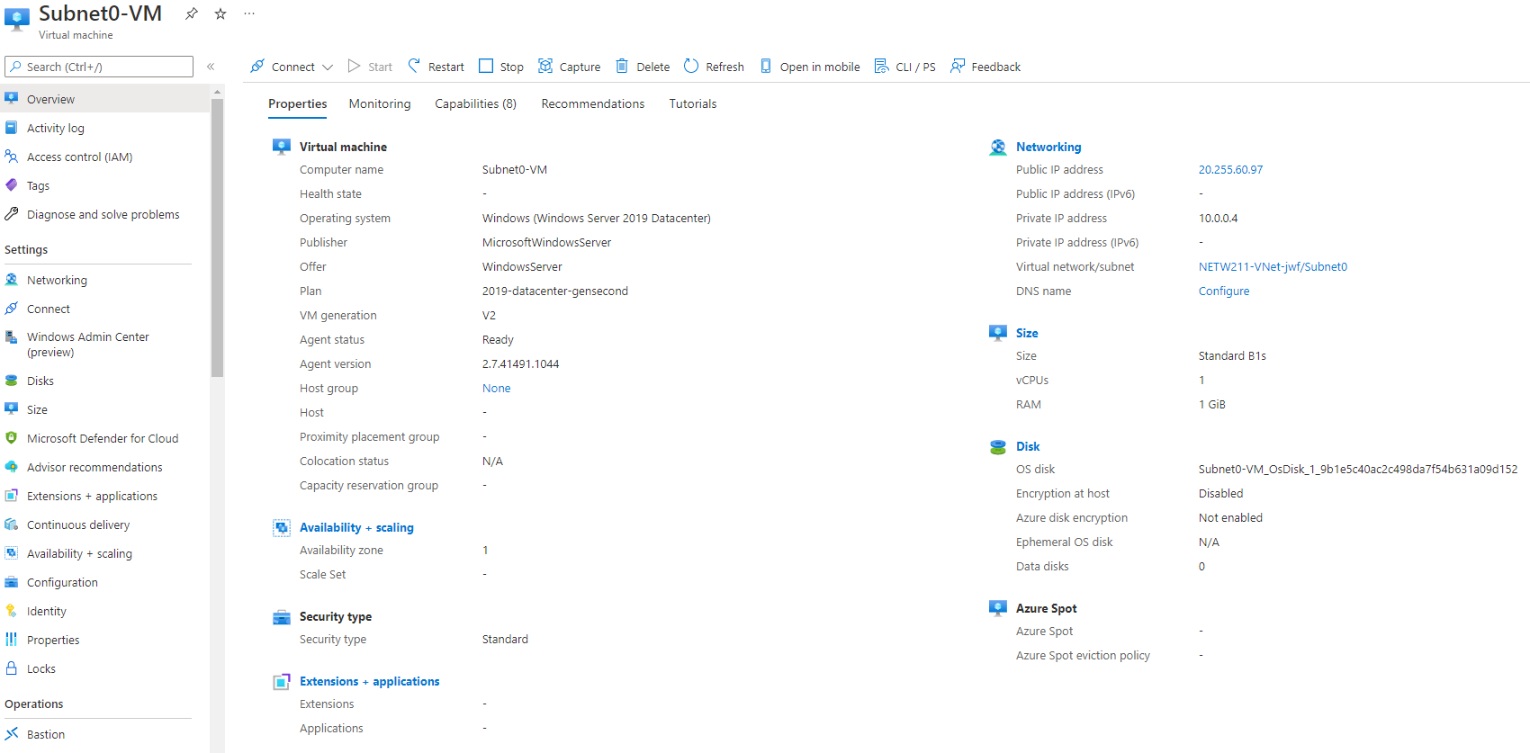
Deploying VMs into Subnets
This screenshot should show the Properties section of the Subnet0-VM page, showing the networking and size information of the VM.

Slide 5
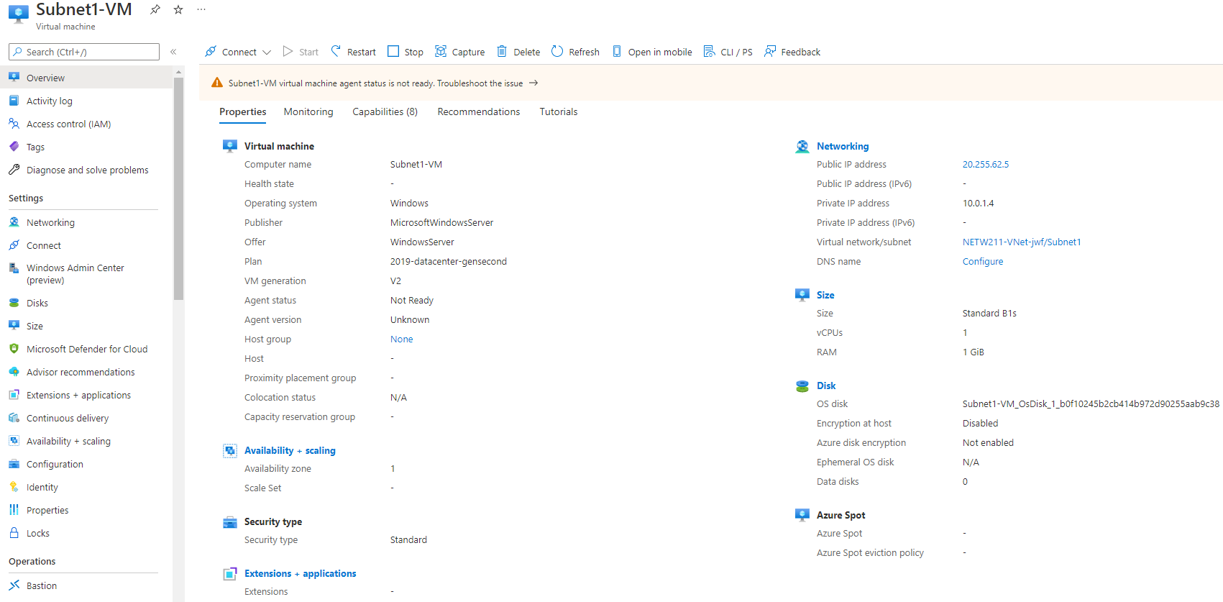
Deploying VMs into Subnets cont’d
This screenshot should show the Properties section of the Subnet1-VM page, showing the networking and size information of the VM.

Slide 6
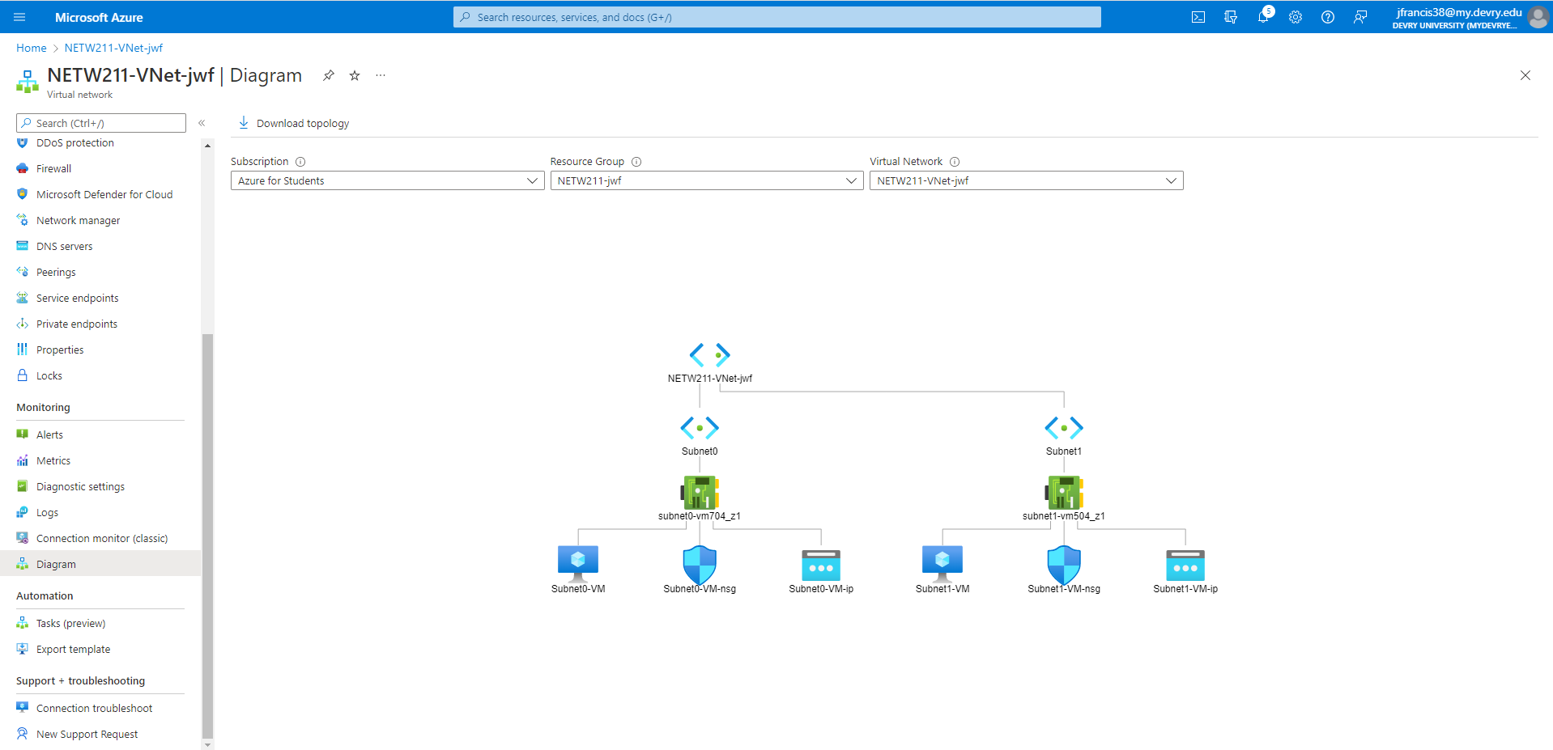
Deploying VMs into Subnets cont’d
This screenshot should show the topology diagram of your VNet (NETW211-VNet-Your Initials) with two subnets (Subnet0 and Subnet1) and one VM in each subnet (Subnet0-VM and Subnet1-VM).

Slide 7
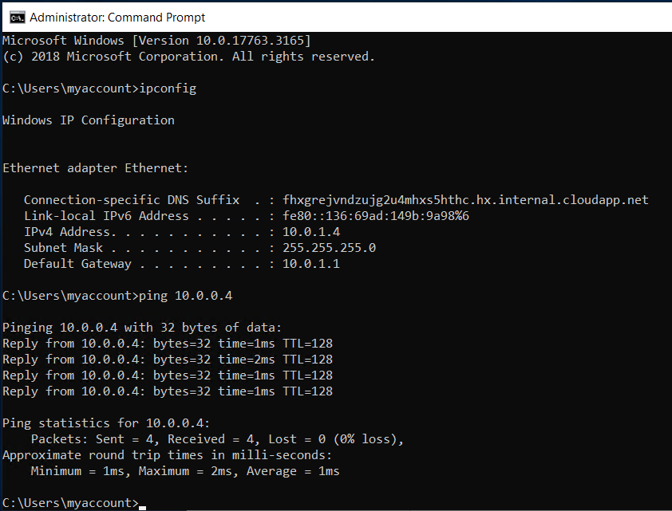
Verifying Connectivity between VMs
This screenshot should show the ipconfig and ping x.x.x.x results in the command prompt window, including the Subnet0-VM – x.x.x.x – Romote Desktop Connection window title.

Slide 8
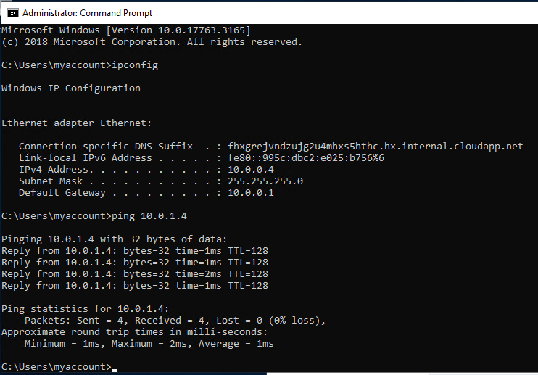
Verifying Connectivity between VMs
cont’d
This screenshot should show the ipconfig and ping x.x.x.x results in the command prompt window, including the Subnet1-VM – x.x.x.x – Romote Desktop Connection window title.

